Slide 1

github.com/atoosa-r
github.com/atoosa-r
RECOMMENDATION SYSTEMS
ATOOSA RASHID
1

Slide 2
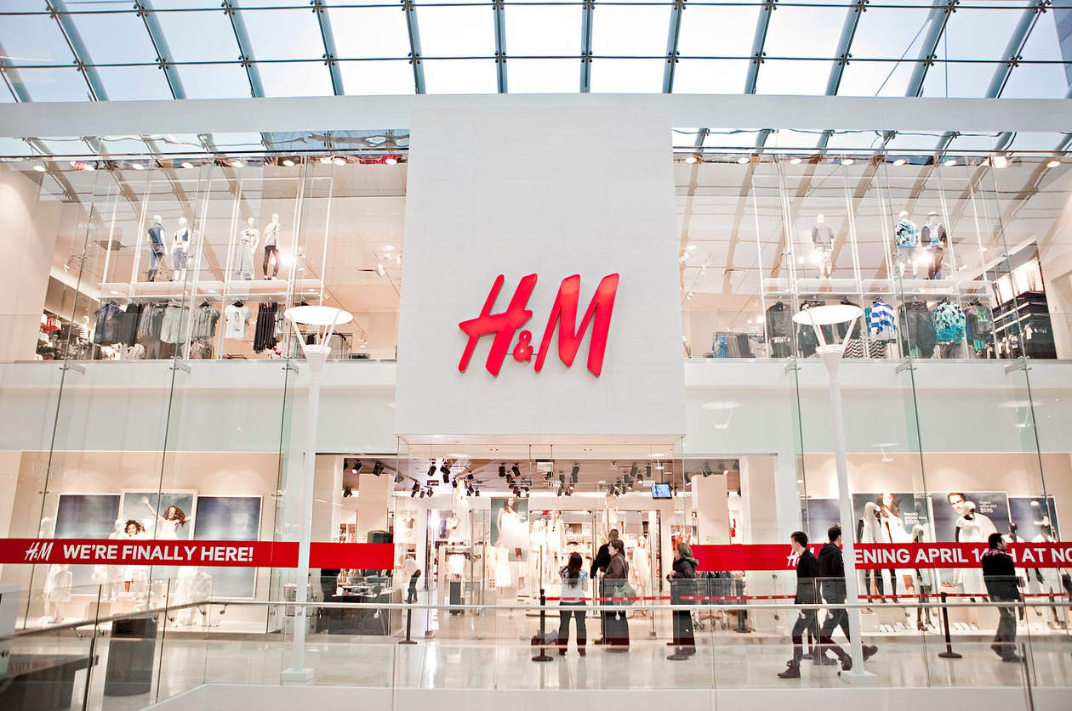
OVERVIEW
Problem: Difficulty finding suitable fashion items.
Solution: Personalized recommendation system.
Impact: Enhanced shopping experience, increased satisfaction, reduced returns.
2

Slide 3
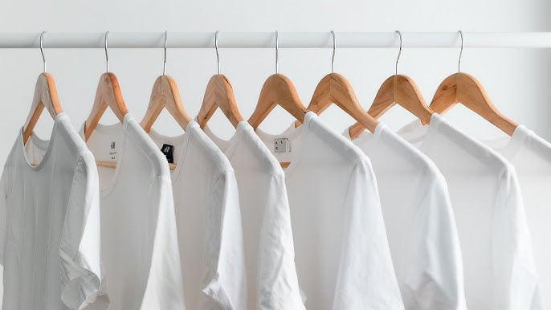
Datasets: Transactions, Articles, Customers.
Preprocessing: Cleaning, Feature Engineering, Text Processing.
Data Source: The dataset is sourced from H&M's transactional and product databases.
DATASET & PREPROCESSING
3

Slide 4
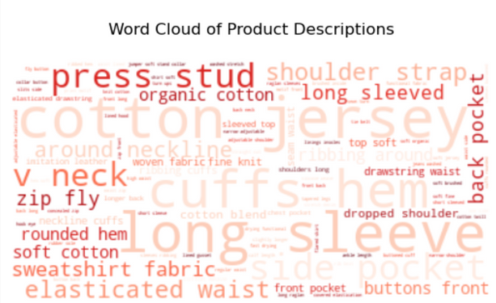
EXPLORATORY DATA ANALYSIS
PREPROCESSING
MODELING
Building on initial EDA
Reviewing top words within product descriptions
Analyzing top words by department
Data Cleaning: Removed duplicates and handled missing values to ensure data quality.
Text Processing: Tokenized product descriptions, removed stopwords. Preparing for word embedding.
Creating seperate matrices
Collaborative Filtering
With Cosine Similarity
User-Item Matrix creation
Matrix Factorization
FunkSVD algorithm
Surprise Library
4

Slide 5
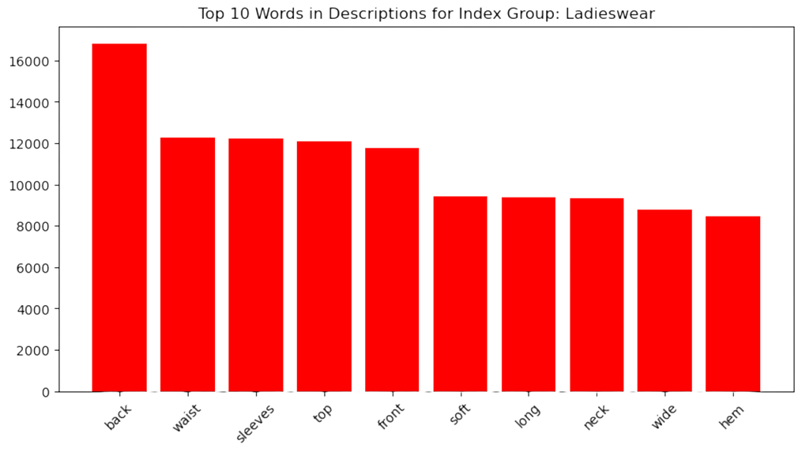
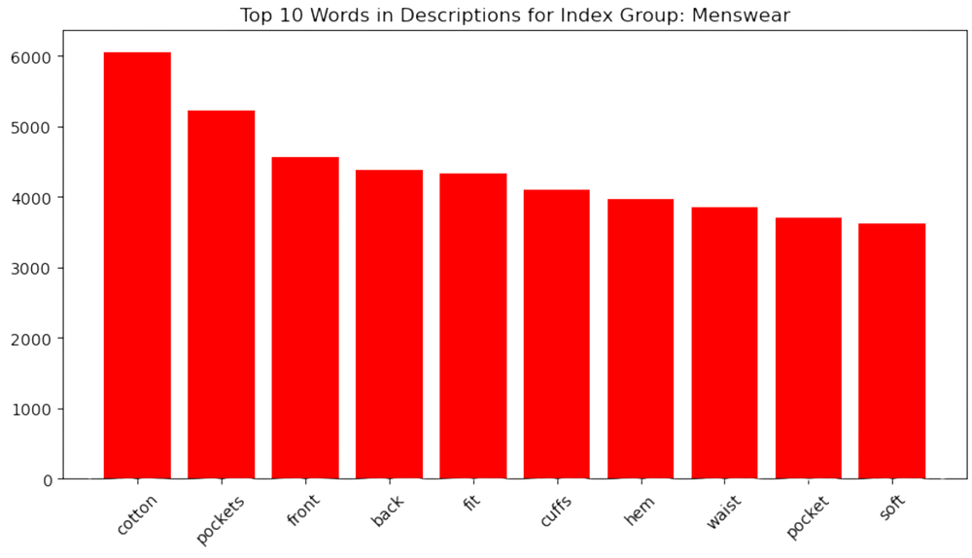
EXPLORATORY DATA ANALYSIS (EDA)
5

Slide 6
BASELINE MODEL AND EVALUATION
Collaborative Filtering:
Measuring cosine similarity between customers based on purchase history.
Identifying customers with similar tastes.
User-Item Matrix:
Created a user-item matrix where each row represents a customer and each column represents an article.
Evaluation:
Evaluated the recommendations by checking the similarity scores and the relevance of suggested items.
6

Slide 7
INPUT CUSTOMER ID
COLLABORATIVE FILTERING
RECOMMENDATION
GET CUSTOMER SIMILARITY SCORES
IDENTIFY TOP SIMILAR CUSTOMERS
RECOMMEND ARTICLES
PRINT OUT TOP 5 ARTICLE IDS, ARTICLE NAMES, AND IMAGES
7

Slide 8
EXAMPLE :
0EFC7ABE48C4111B1386BC7F122AACDC291AF2C31541609C488A38D7383D6ED0
COLLABORATIVE FILTERING
RECOMMENDATION
GET CUSTOMER SIMILARITY SCORES
IDENTIFY TOP SIMILAR CUSTOMERS
RECOMMEND ARTICLES
RECOMMENDED ARTICLES:
ARTICLE ID: 433414020, PRODUCT NAME: MARIA NT 2-PACK
ARTICLE ID: 663382005, PRODUCT NAME: WINSTON CHELSEA BOOT ARTICLE ID: 674606004, PRODUCT NAME: CHARLIE SKIRT
ARTICLE ID: 749878001, PRODUCT NAME: FUNC. INGELA SNOW JACKET
ARTICLE ID: 783346030, PRODUCT NAME: PRIMO SLACKS
8

Slide 9
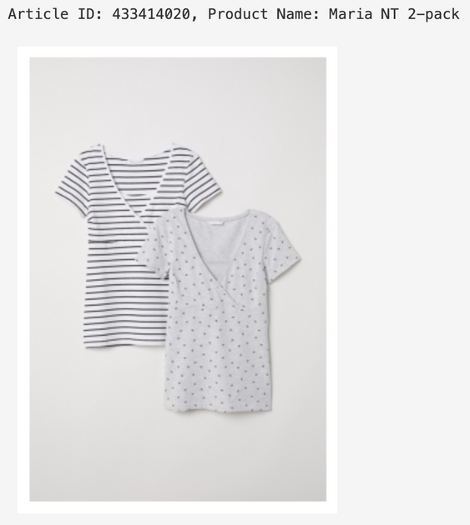
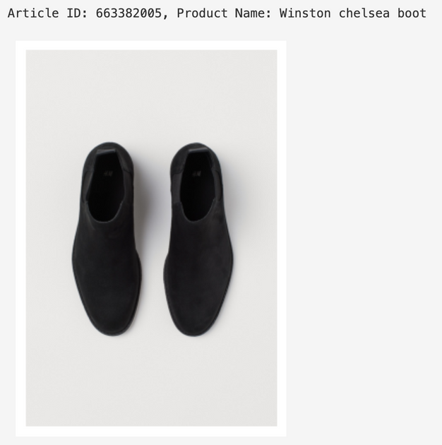
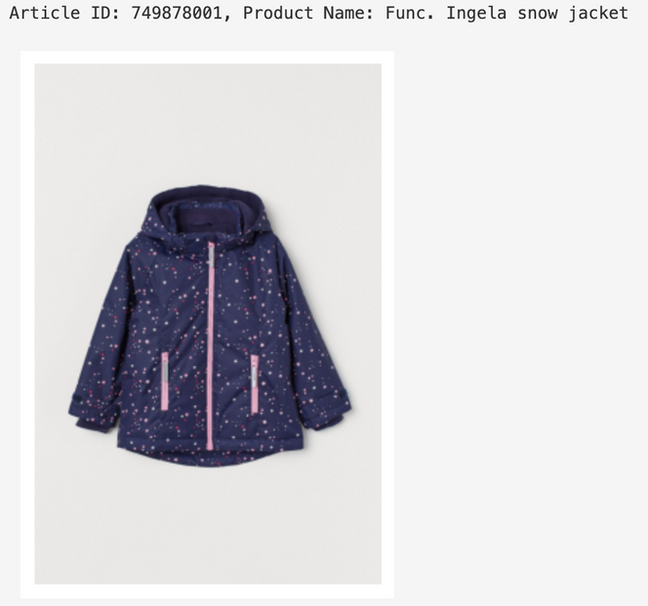
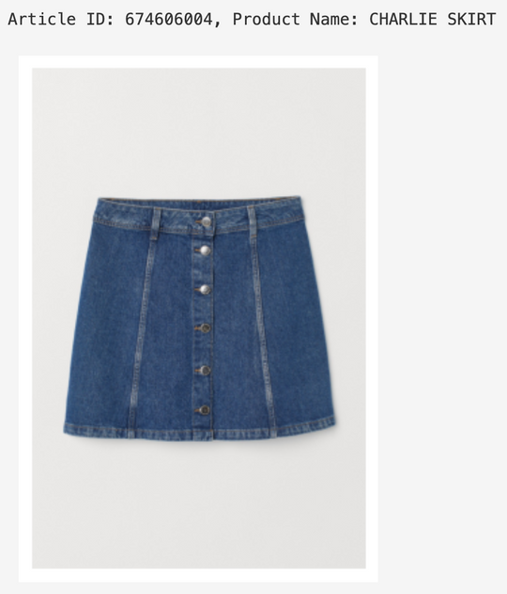
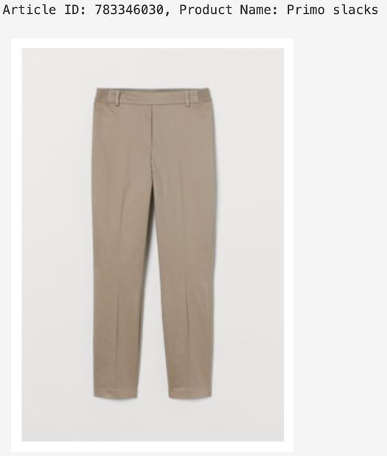
9

Slide 10
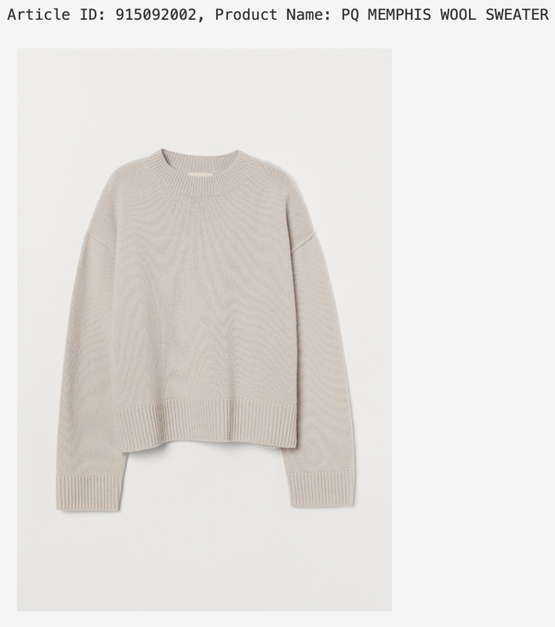
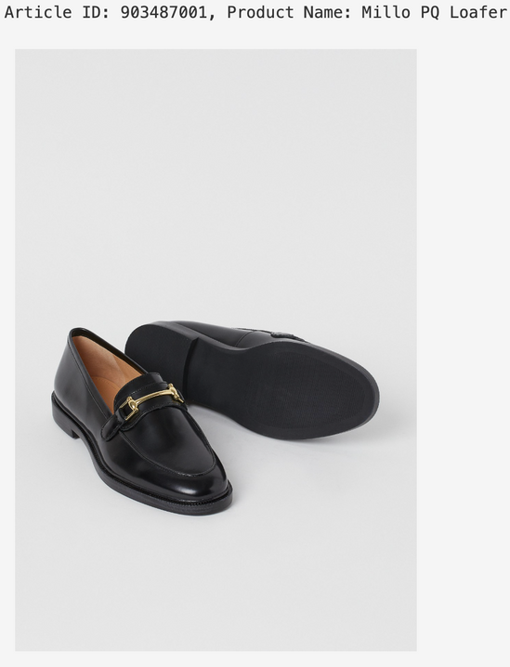
PREVIOUS PURCHASES
10

Slide 11
ADVANCED MODELING: MATRIX FACTORIZATION
Matrix Factorization (FunkSVD):
Scoring system (0 to 5)
Decomposing large matrix into product of two smaller matrices
Uses linear methods and gradient descent for optimization
Customer matrix (C) and Article matrix (A)
Goal: Capturing latent features that describe the underlying relationship between customers and articles of clothing purchased
Evaluation:
Evaluating the accuracy of predicted ratings
RMSE (0.17), MSE ( 0.029), MAE (0.09), and FCP (0.63)
11

Slide 12
EXAMPLE :
0EFC7ABE48C4111B1386BC7F122AACDC291AF2C31541609C488A38D7383D6ED0
MATRIX FACTORIZATION
RECOMMENDATION
LOAD & PREPARE DATA
HYPERPARAMATER TUNING
TRAIN THE MODEL
GENERATE RECCOMENDED ITEMS BASED ON PREDICTED SCORES
EVALUATE MODEL
RECOMMENDED ARTICLES:
ARARTICLE ID: 538699007, PRODUCT NAME: V-NECK STRAP TOP
ARTICLE ID: 876009004, PRODUCT NAME: NAT LS CORD
ARTICLE ID: 833534001, PRODUCT NAME: MC CAIRN TWEED JACKET
ARTICLE ID: 856270003, PRODUCT NAME: BOUNCE SEAMLESS CROPPED
ARTICLE ID: 906226001, PRODUCT NAME: SQUARED TOP
12

Slide 13
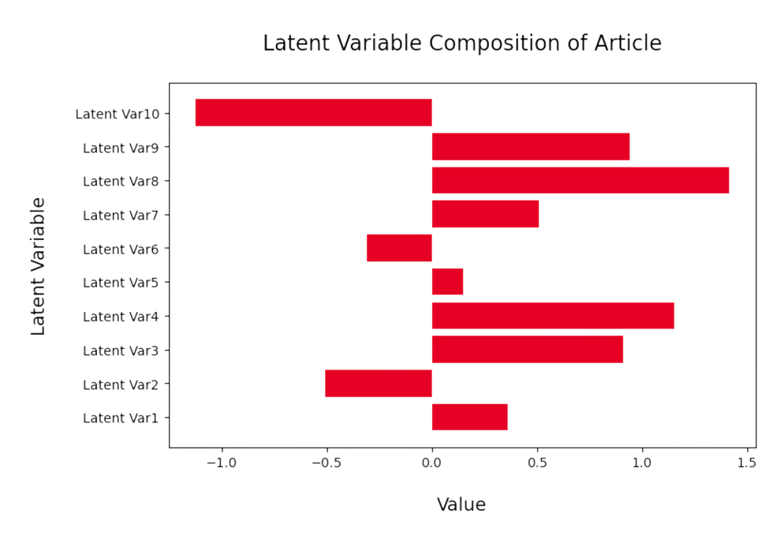
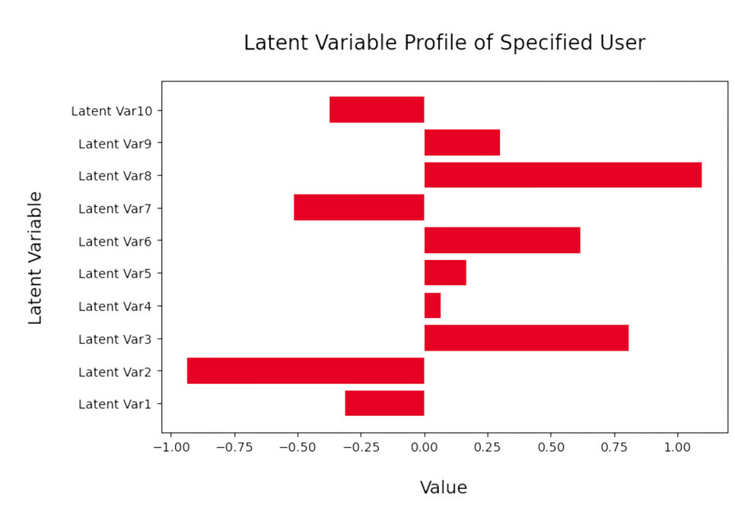
LATENT LAYERS
13

Slide 14
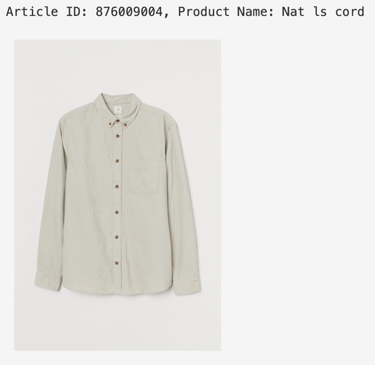
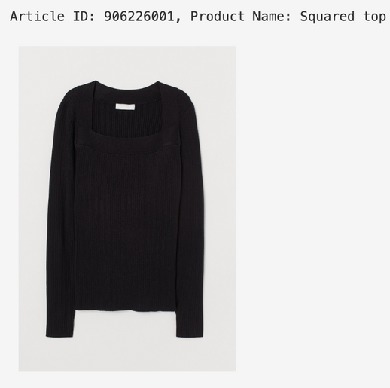
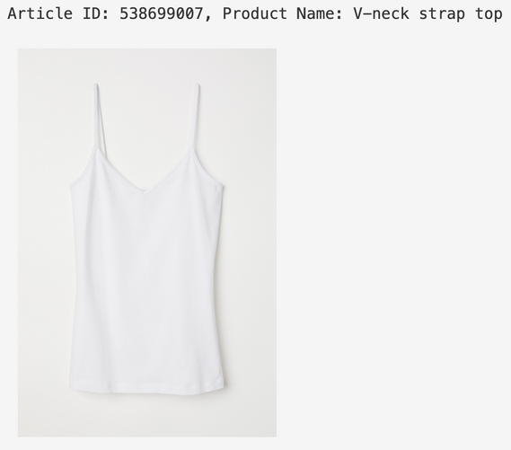
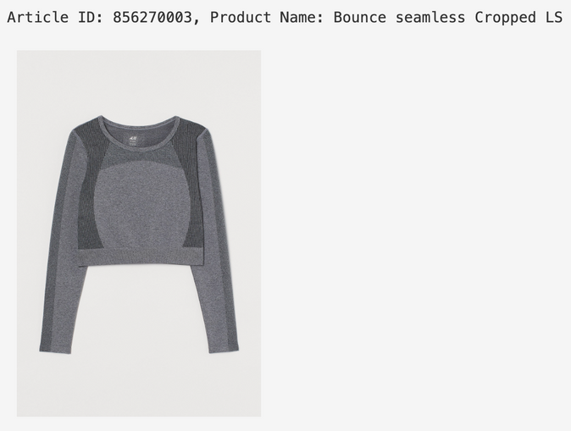
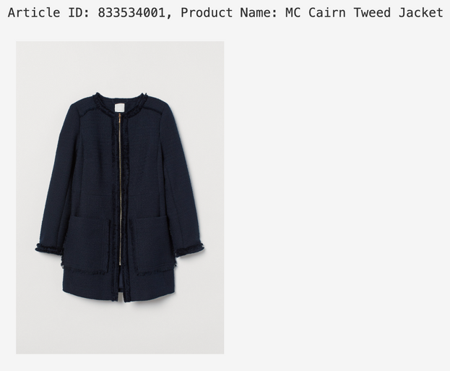
14

Slide 15
Exploring Existing Reccomender Systems
Evaluating latent layers
TensorFlow Recommender
Incorporating user and word embedding
Visualizing Recommendations
Streamlit
NEXT STEPS
15

Slide 16
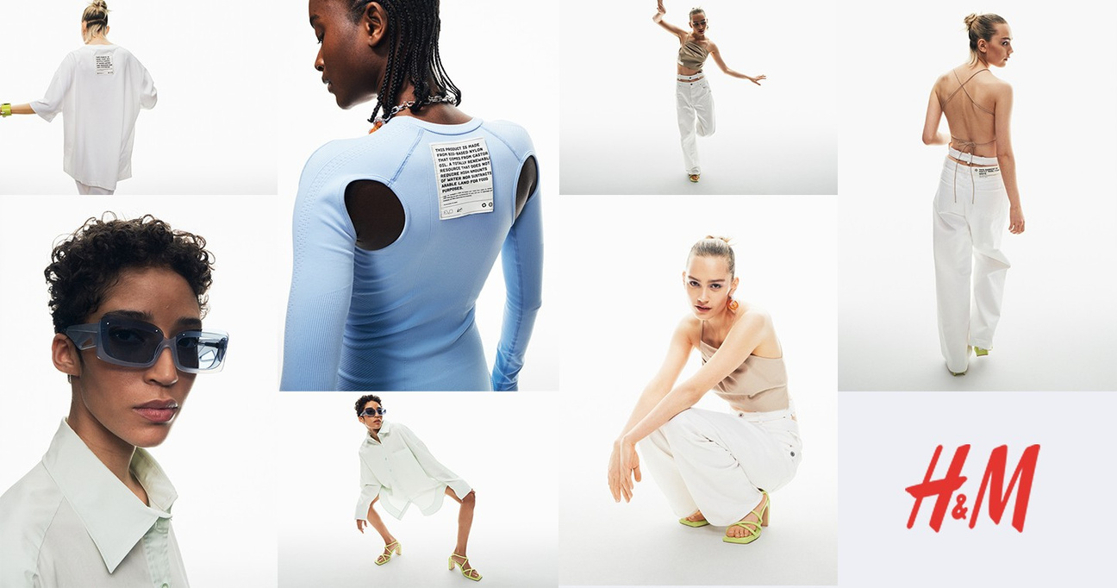
THANK YOU
QUESTIONS?
16

